Slide 1
Helping Yelp
Springboard - Capstone project 1
Final Report

Slide 2
…
RESULTS
 | Count | count stop | count stop ngram | count stop ngram lda | tfidf | tfidf stop | 'tfidf stop ngram | tfidf stop ngram nmf | Word to Vector100 | Word to Vector200 | Word to Vector1000
Naive Bayes | 0.559 | 0.568 | 0.583 | 0.583 | 0.527 | 0.536 | 0.573 | 0.574
Logistic Regression | 0.540 | 0.548 | 0.550 | 0.550 | 0.570 | 0.580 | 0.587 | 0.587 | 0.546 | 0.556 | 0.560
SVM | 0.510 | 0.517 | 0.519 | 0.520 | 0.563 | 0.578 | 0.586 | 0.585 | 0.552 | 0.555 | 0.554
Random Forest | 0.510 | 0.511 | 0.514 | 0.473 | 0.519 | 0.522 | 0.524 | 0.522 | 0.505 | 0.513 | 0.518
SGD | 0.510 | 0.516 | 0.528 | 0.524 | 0.555 | 0.564 | 0.573 | 0.573 | 0.458 | 0.482 | 0.494
XG Boost | 0.547 | 0.549 | 0.556 | 0.560 | 0.544 | 0.553 | 0.556 | 0.571 | 0.526 | 0.532 | 0.536
Deep Neural Net | 0.587 | 0.589 | 0.603 | 0.587 | 0.582 | 0.582 | 0.605 | 0.600 | 0.557 | 0.559 | 0.560

Slide 3
…
RESULTS FOR 2X
 | Count | count stop | count stop ngram | count stop ngram lda | tfidf | tfidf stop | 'tfidf stop ngram | tfidf stop ngram nmf | Word to Vector100 | Word to Vector200 | Word to Vector1000
Naive Bayes | 0.580 | 0.590 | 0.606 | 0.606 | 0.554 | 0.564 | 0.602 | 0.603
Logistic Regression | 0.580 | 0.588 | 0.594 | 0.595 | 0.596 | 0.608 | 0.621 | 0.621 | 0.571 | 0.587
SVM
Random Forest | 0.540 | 0.543 | 0.550 | 0.508 | 0.546 | 0.552 | 0.556 | 0.555 | 0.531
SGD | 0.550 | 0.559 | 0.575 | 0.573 | 0.569 | 0.578 | 0.594 | 0.594 | 0.536 | 0.551 | 0.562
XG Boost
Deep Neural Net | 0.603 | 0.611 | 0.628 | 0.615 | 0.603 | 0.618 | 0.628 | 0.623 | 0.588 | 0.600 | 0.595

Slide 4
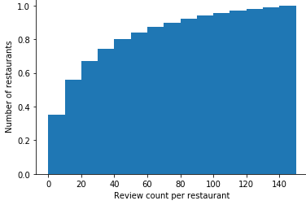
A single review can greatly impact most restaurants
Cumulative Distribution of review counts
Majority of restaurants have < 20 reviews
Only 15% (~7,000) of restaurants have over 100 reviews

Slide 5
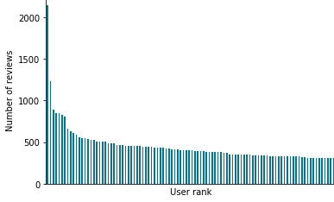
Although the top users are prolific reviewers…
Number of reviews written by the top reviewers (each)
Rank Number of reviews
1st 2,150
2nd 1,234
3rd 886
100th 306
1000th 120
2000th 84
1
100

Slide 6
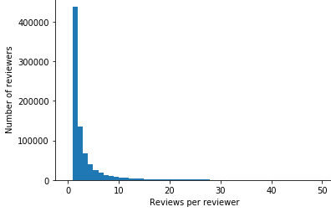
… they only write a small proportion of reviews, most reviews are written by first timers
Distribution of restaurant reviews per user
54% of all reviews are written by users with only 1 review

Slide 7
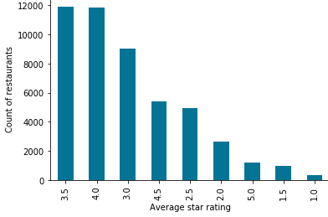
On average, restaurants are rated fair to good (3-4 stars)
Distribution of Average star ratings for restaurants
Expected value = 3.4

Slide 8
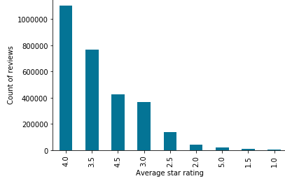
Restaurants with better ratings tend to get more reviews
Distribution of Reviews by restaurant’s average star rating
Restaurants with better reviews get more reviews.
Notice that the distribution of reviews does not follow the distribution of restaurants with those ratings.

Slide 9
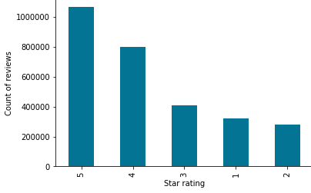
There is no obvious ‘representative’ star rating that will be fair to restaurants
Distribution of star ratings of reviews in the dataset
Expected value = 3.7
Star ratings in reviews are skewed towards high ratings.
The mode rating (5 stars) is much higher than the expected value for reviews (3.7 stars) and for restaurants (3.4 stars).

Slide 10
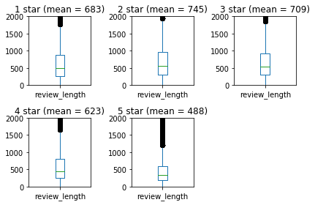
The length of a review appears to be a poor proxy indicator of star ratings
Distribution of number of characters in a review by stars
No strong correlation between review length distribution and star ratings

Slide 11
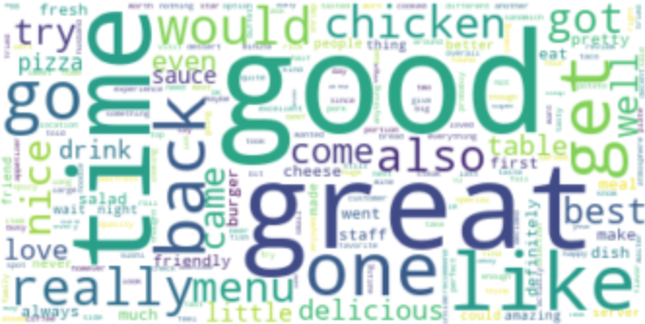


Analysis of the text give might provide a fair ‘representative’ star rating
N-gram word clouds
Uni-gram
Complexity
Bi-gram
Tri-gram

Slide 12
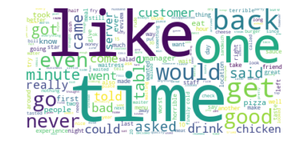
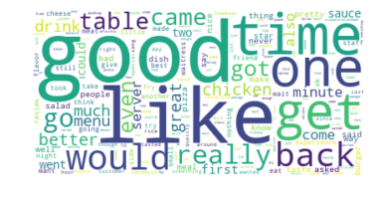
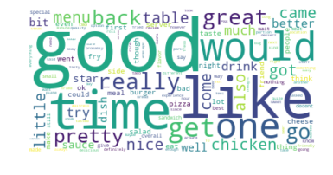
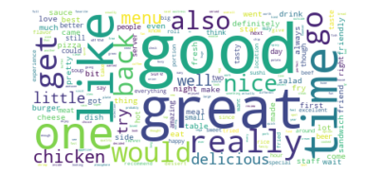
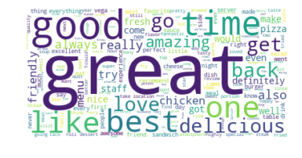
Basic analysis of top words used, suggest differences based on star ratings
top words in reviews grouped by star ratings
Word
cloud
Rank of word in terms of frequency of use (in text by star rating):
1
.
.
.
5
.
.
.
10
time
like
one
back
get
would
go
good
even
never
good
like time one get would back really go table
good
like time would one get really great go back
good great like time one really get go would back
great good time best one like delicious go back love

Slide 13
Basic analysis of top words used, suggest differences based on star ratings
top words in reviews grouped by star ratings
Word
cloud
Rank of word in terms of frequency of use (in text by star rating):
best
great
good
ok
bad
never
153
60
8
118
22
10
76
16
1
50
30
48
56
8
1
35
48
110
31
2
1
251
148
97
4
1
2
540
221
55
Top 10

Slide 14
Next steps
Analyze text and build a model to determine star rating based on review’s text

